Slide 1
HELP International NGO
How to use funding money ($10 million) strategically and effectively
.

Slide 2
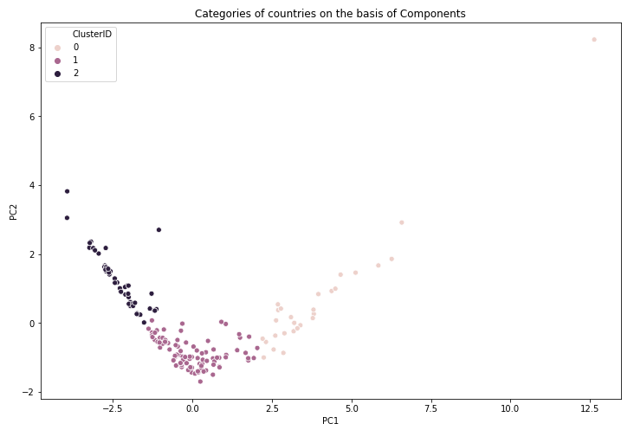
Categories of countries on the basis of Components
we can clearly see the 3 categories of countries here from plots.
0:- Developed Countries
1:- Developing Countries
2:- Under-Developed Countries

Slide 3
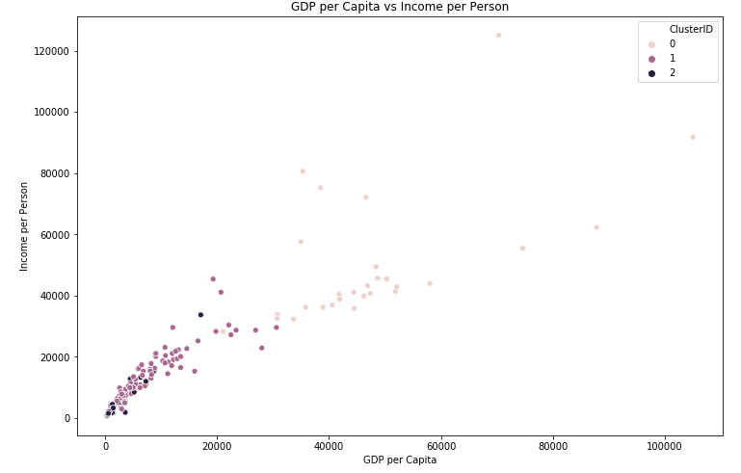
GDP per Capita vs Income per Person
From above scatter plot of GDPP and income, we can see there is some clustering like where GDPP is more, then income is also more.

Slide 4
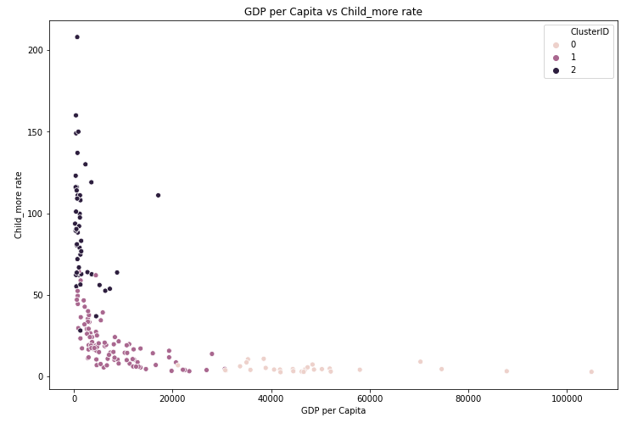
GDP per Capita vs Child_morT rate
From above scatter plot of GDPP and child-mort, we can see there is some grouping where GDPP is more, there child-mort is low.

Slide 5
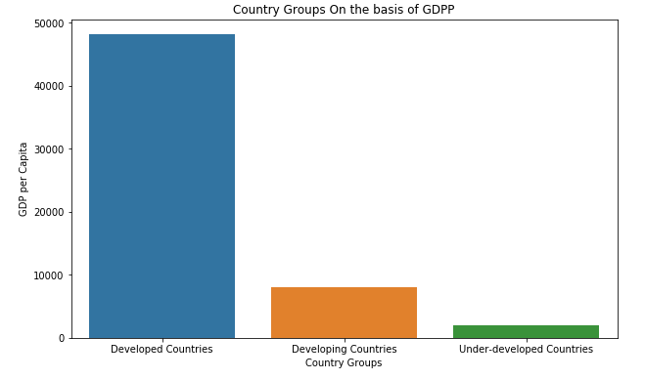
Country Groups On the basis of GDPP
Above bar chart shows that, all the developed countries are having high GDP per capita values, developing countries are having average GDP per capita values and poor countries are having the least GDPP values.

Slide 6
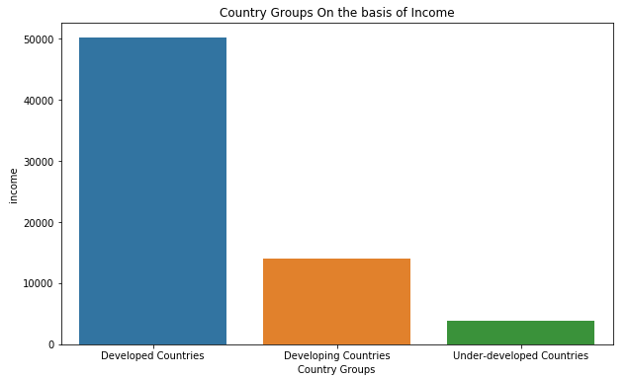
Country Groups On the basis of Income
Similarly, Above bar chart shows that, all the developed countries are having high income per person, developing countries are having average income per person and poor countries are having the least income per person.

Slide 7
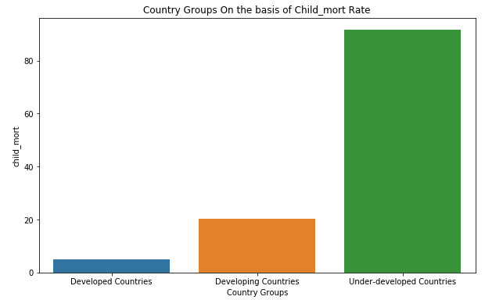
Country Groups On the basis of Child_mort Rate
So, Above bar chart shows that, all the developed countries are having low number of death of children under 5 years of age per 1000 live births, developing countries are having average death rate and poor countries are having the higher death rate.

Slide 8
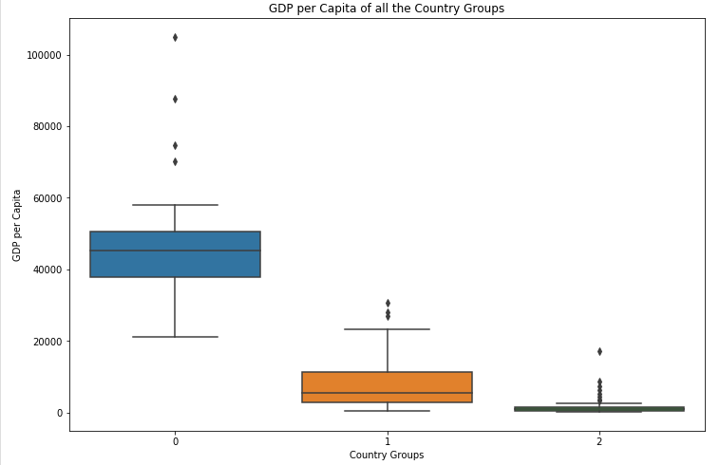
GDP per Capita of all the Country Groups
Here, Developed countries are falling under Group 0 because of high GDPP range. Poor countries are falling under Group 2, Where GDPP value is very low.

Slide 9
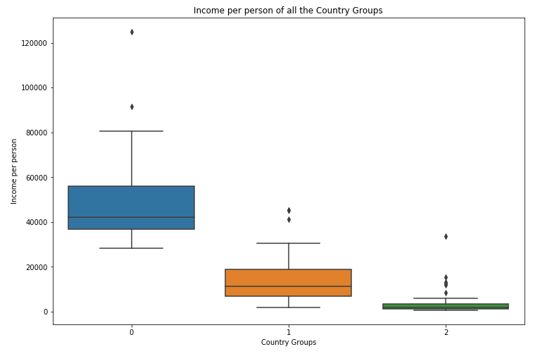
Income per person of all the Country Groups
Here, As Developed countries are falling under 1st group that is 0, So the income is in high range i.e. under group 0. Poor countries are falling under group 2 as per the income also.

Slide 10
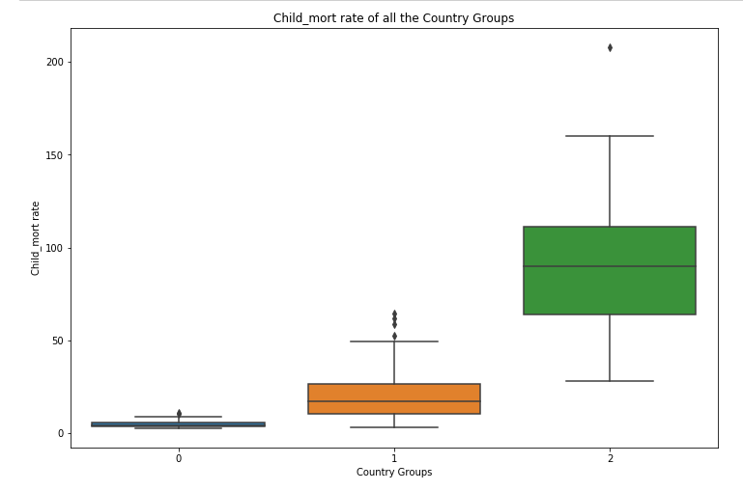
Child_mort rate of all the Country Groups
From the above plots we can see poor countries are falling under group 2. So, the child mort rate is more in these countries.

Slide 11
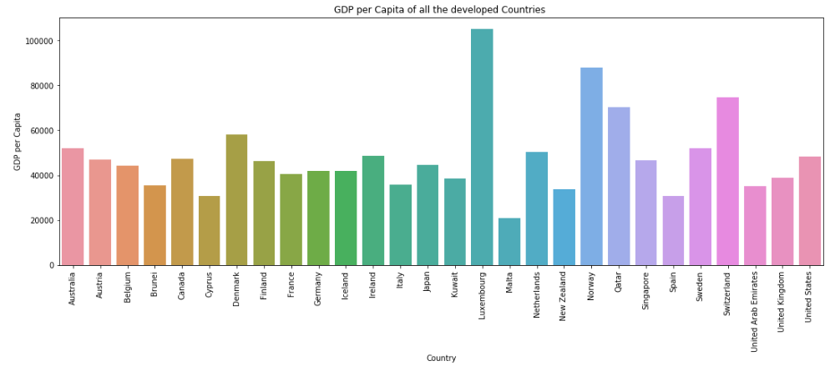
GDP per Capita of all the developed Countries
From the above bar chart, we can see all the developed countries like Luxembourg, Australia, etc. are having high GDP per capita.

Slide 12
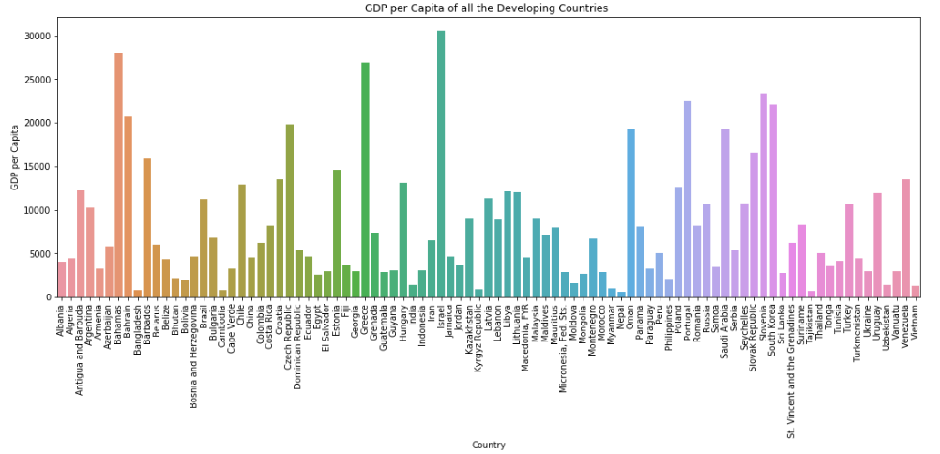
GDP per Capita of all the Developing Countries
From the above barchart, we can see all the Developing countries like Iran, Albania, etc. as per GDPP.

Slide 13
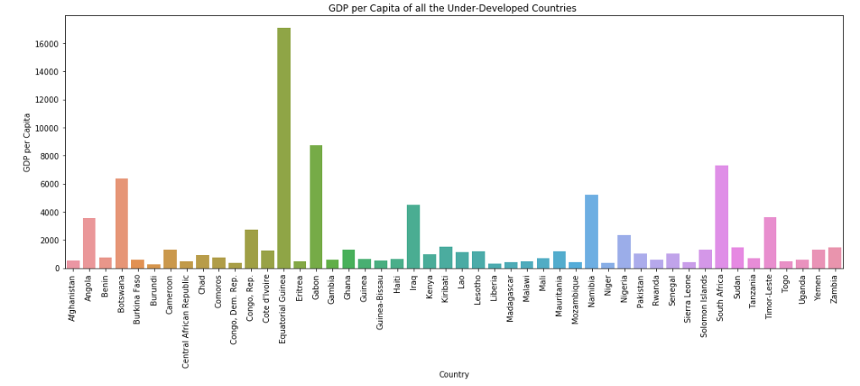
GDP per Capita of all the Under-Developed Countries
From the above bar chart, we can see all the Under-developed countries like Burundi, Afghanistan, etc, where GDPP values are very low.

Slide 14
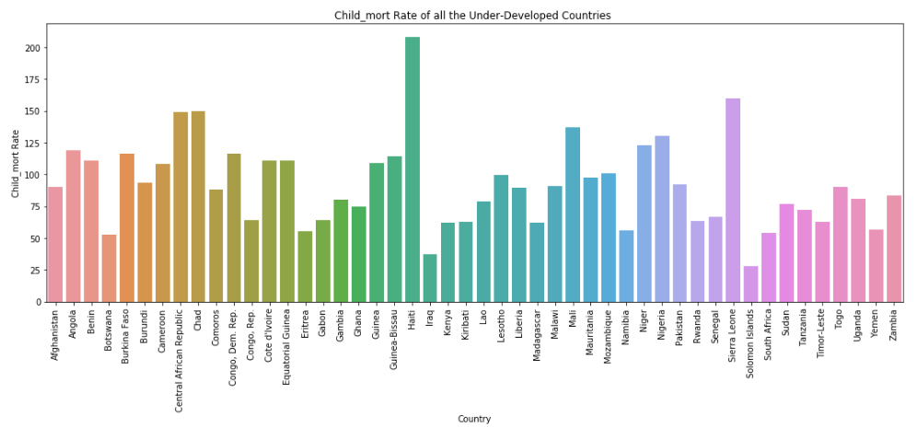
Child_mort Rate of all the Under-Developed Countries
From the above barchart, we can see all the Under-developed countries like Haiti, Sierra Leone, etc., where Death of children under 5 years of age per 1000 live births (child_mort rate) is high.

Slide 15
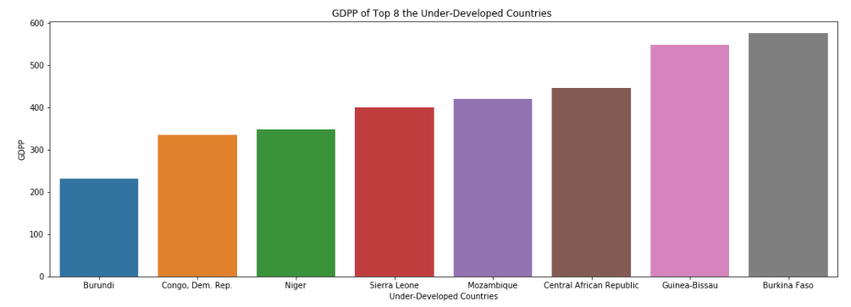
GDPP of Top 8 the Under-Developed Countries
Top 8 under-developed countries in under-development group, where GDPP is very low of countries like Burundi, Congo, etc.

Slide 16
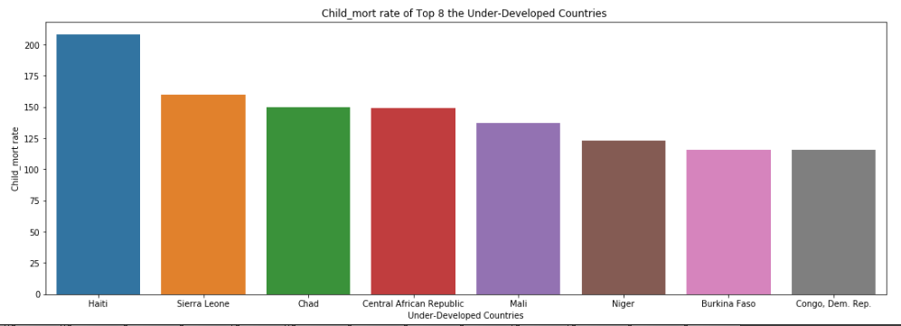
Child_mort rate of Top 8 the Under-Developed Countries
Top 8 under-developed countries in under-development group, where child death is very high in countries like Haiti, Sierra, etc.

Slide 17
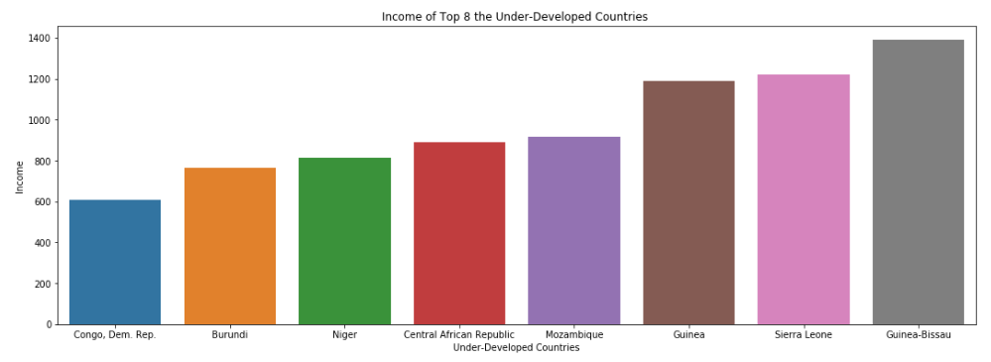
Income of Top 8 the Under-Developed Countries
Top 8 under-developed countries in under-development group, where income is very low of countries like Congo, Burundi, etc.

Slide 18
Conclusion
After grouping all the countries into 3 groups by using some socio-economic and health factors, we can determine the overall development of the country.
Here, the countries are categorised into list of developed countries, developing countries and under-developed countries.
In Developed countries, we can see the GDP per capita and income is high where as Death of children under 5 years of age per 1000 live births i.e. child-mort is very low, which is expected.
In Developing countries and Under-developed countries, the GDP per capita and income are low and child-mort is high. Specifically, for under-developed countries, the death rate of children is very high.

Slide 19
Recommendations
From bar chats, we can clearly see the socio-economic and heath situation of the under developed countries.
In countries like Haiti, Sierra Leone, Chad, etc., the death rate of children under 5 years of age per 1000 (child-mort) is high.
In countries like Burundi, Congo, Niger, etc., GDP per capita is very low. So, in those countries, the income per person is also low. So, these countries are considered as poor countries.
Finally, as per categories of the countries, top 8 under-developed countries which are in direst need of aid are as below:
Burundi
Congo, Dem. Rep.
Niger
Sierra Leone
Haiti
Chad
Central African Republic
Mozambique

Slide 20
Thank You
- Subhajit Nayak

